Slide 1
Online Banking
Presented By:
213 Java SL KK(Group-5)

Slide 2
PROJECT MEMBERS
Mallikarjun 2485045
Mohammed Asif K S 2485671
Mansi Kumari 2485503
Madala Manasa 2487106
Namala Vijay 2487052
Mallethula Bhavani 2483955
Malathi M 2486723
Lekha S P 2485602
Manaswi D 2487495
Nelakuduru Hemasundar 2486630

Slide 3
CONTENTS
Introduction
Background Of Project
Procedure Of Online Banking
Project Flow
Technology Used
Scope And System Overview
Modules Of Online Banking
UML Diagrams
Testing
Output Screenshots
Features & Advantages
Conclusion

Slide 4
INTRODUCTION
Online banking offers customers almost every service traditionally available through a local branch including deposits, transfers, and online bill payments. Virtually every banking institution has some form of online banking, available both on desktop versions and through mobile apps.
With online banking, consumers aren't required to visit a bank branch to complete most of their basic banking transactions. They can do all of this at their own convenience, wherever they want—at home, at work, or on the go.

Slide 5
Background Of Project
ICIN is one of the top banking firms that accepts deposits from the public. It also invests an amount in securities. Recently, the business analysts noticed a drop in the number of customers of the bank. They found out that online banking systems of banks like AXIS and American Express are gaining more profits by eliminating middlemen from the equation. As a result, the team decided to hire a Full Stack developer who can develop an online banking web application with a rich and user-friendly interface. You are hired as one of the Full Stack Java developers and have been asked to develop the web application. The management team has provided you with the requirements and their business model so that you can easily arrange different components of the application.

Slide 6
Procedure of Online Banking
Online banking investigates the entry threshold providing a new transaction service channel for the use of normal users, Organizations and Academicians. Customer must have a valid user id and password to login to the system. If a wrong password is given in succession, that account will be locked and the customer will not be able to use it.

Slide 7
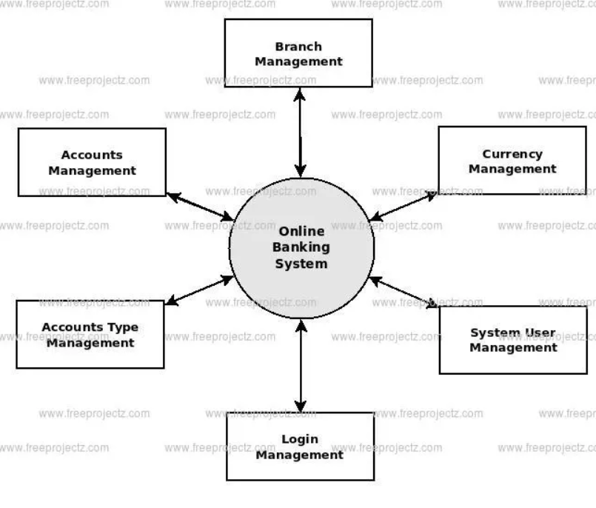
PROJECT FLOW

Slide 8
TECHNOLOGY USED
OPERATING SYSTEM : Windows 10+
FRONT END : Html, CSS, Type script(Angular)
SERVER SIDE SCRIPT : Apache tomcat 8+
DATABASE : MySQL
BACKEND : Spring Boot

Slide 9
Scope and System Overview
Scope:
Customers can perform financial transactions like transfer funds online, pay bills, apply for loans and open a savings account among various other debit card transactions.
System Overview :
The “Online Banking” should support basic functionalities for all below listed users.
Admin
User

Slide 10
ADMIN MODULE
Only Admin can Delete Records, Chequebook Request and Block User.
1. Admin login Page
2. Authorization(KYC)
3. Chequebook Request Approval
4. User Account Info.

Slide 11
USER MODULE
Each User must have a valid user id and password must be running for the system to function users must login in to system to access any record.
User Registration
Login Page
Transaction History
4. Withdraw and Deposit page
5. Transfer History Page
6. Request Chequebook
7. User Session.

Slide 12
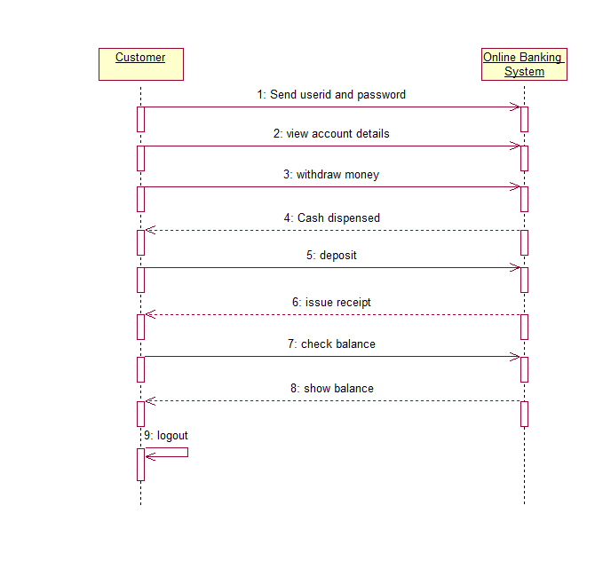
Sequence Diagram For Online Banking

Slide 13
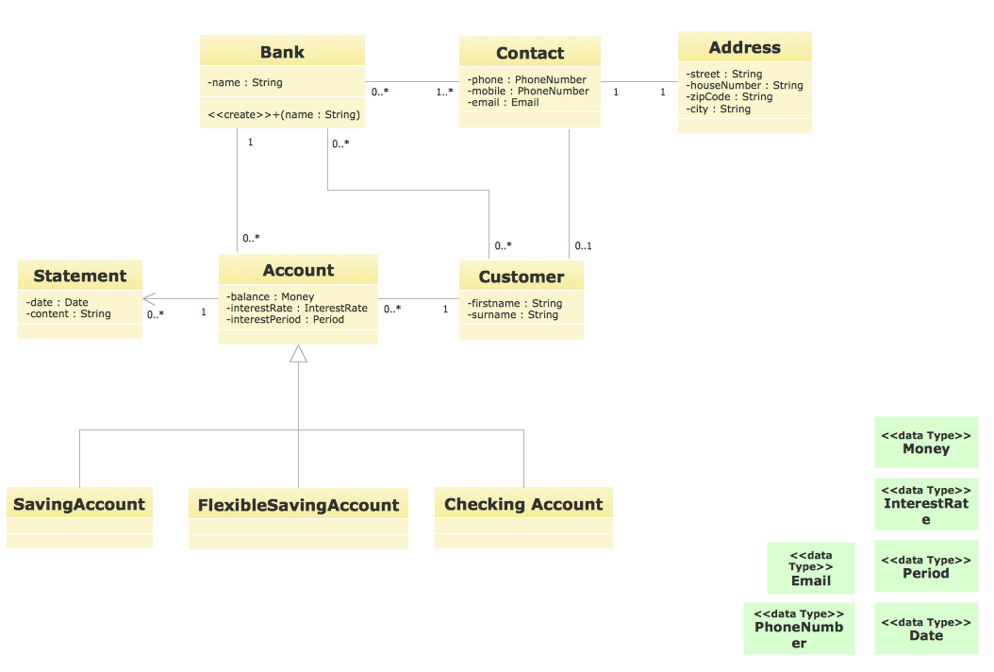
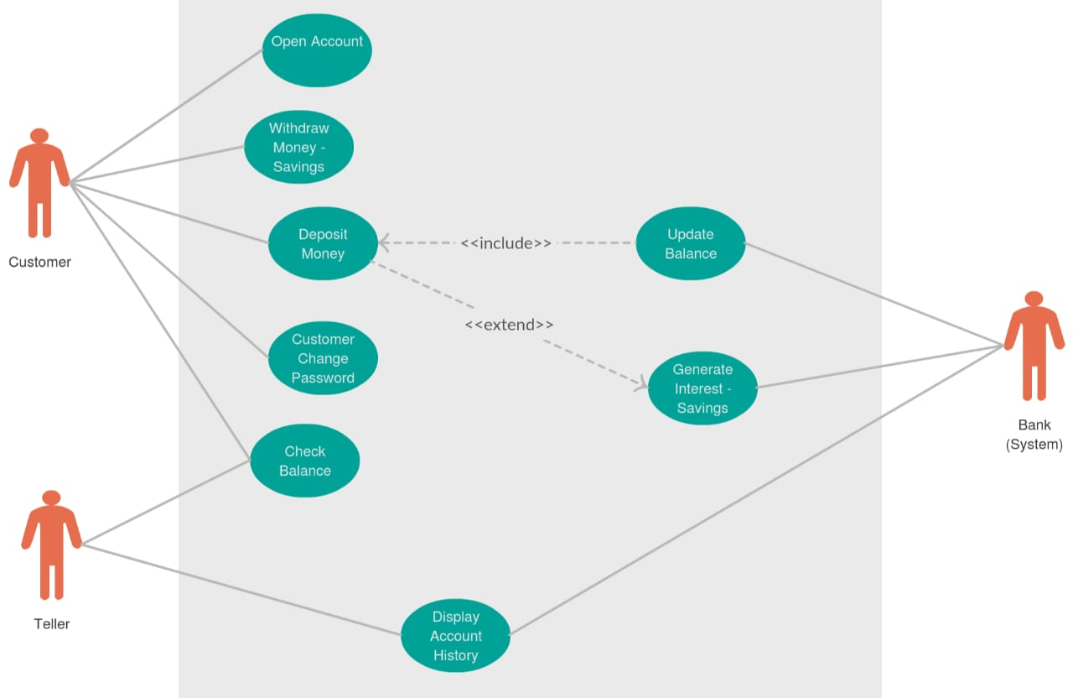
UML Class Diagram and Use case Diagram

Slide 14
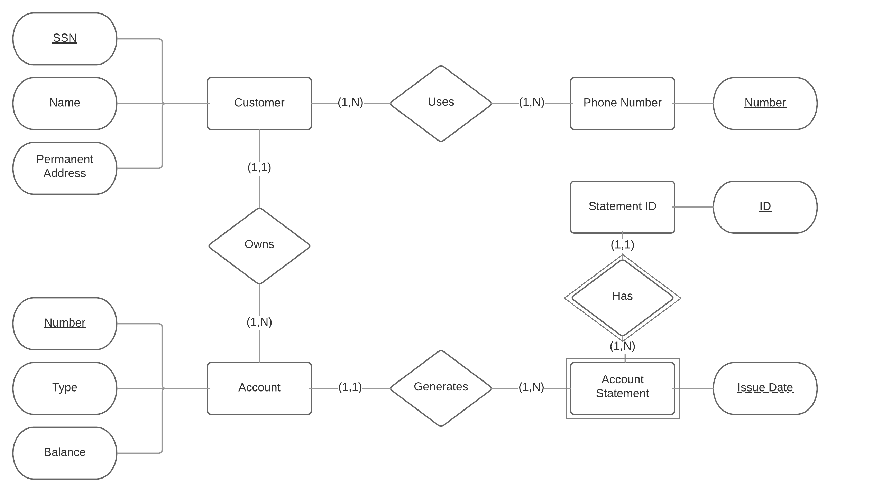
ER Diagram

Slide 15
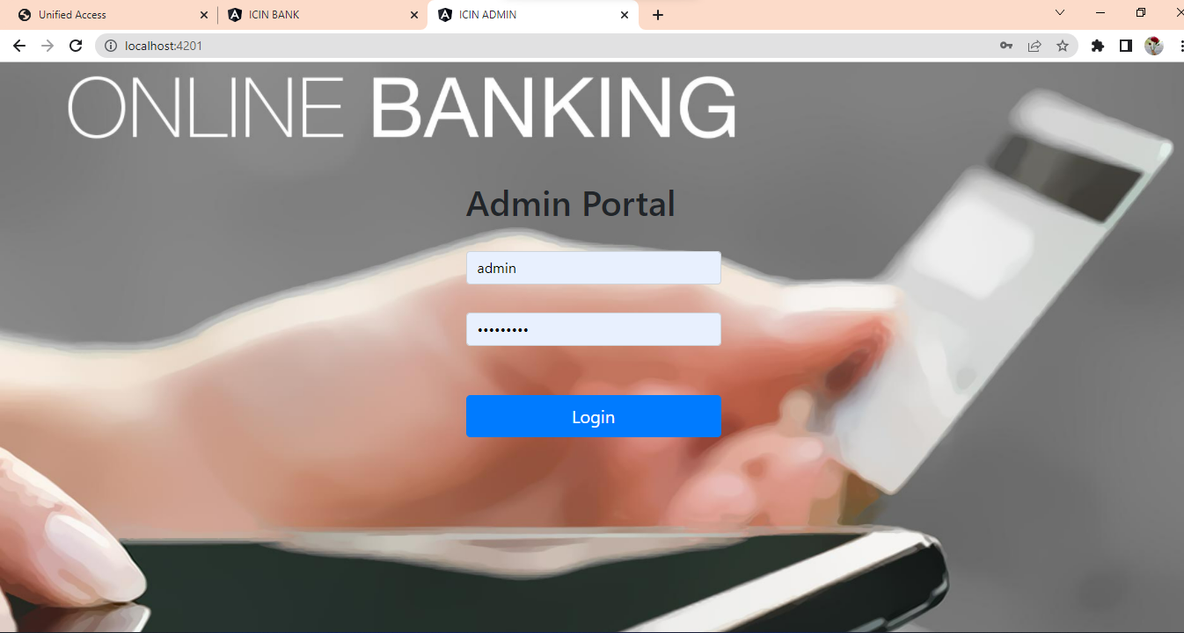
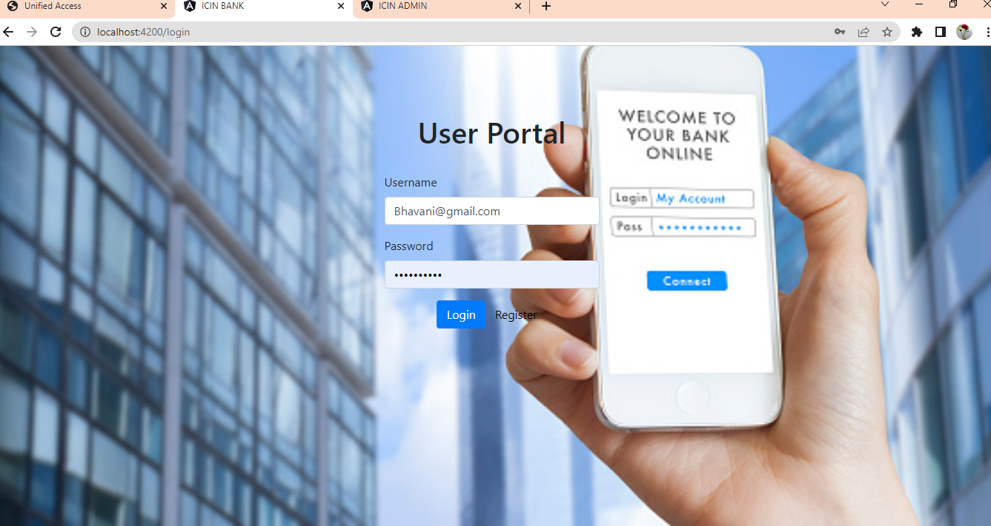
Output Screenshots

Slide 16
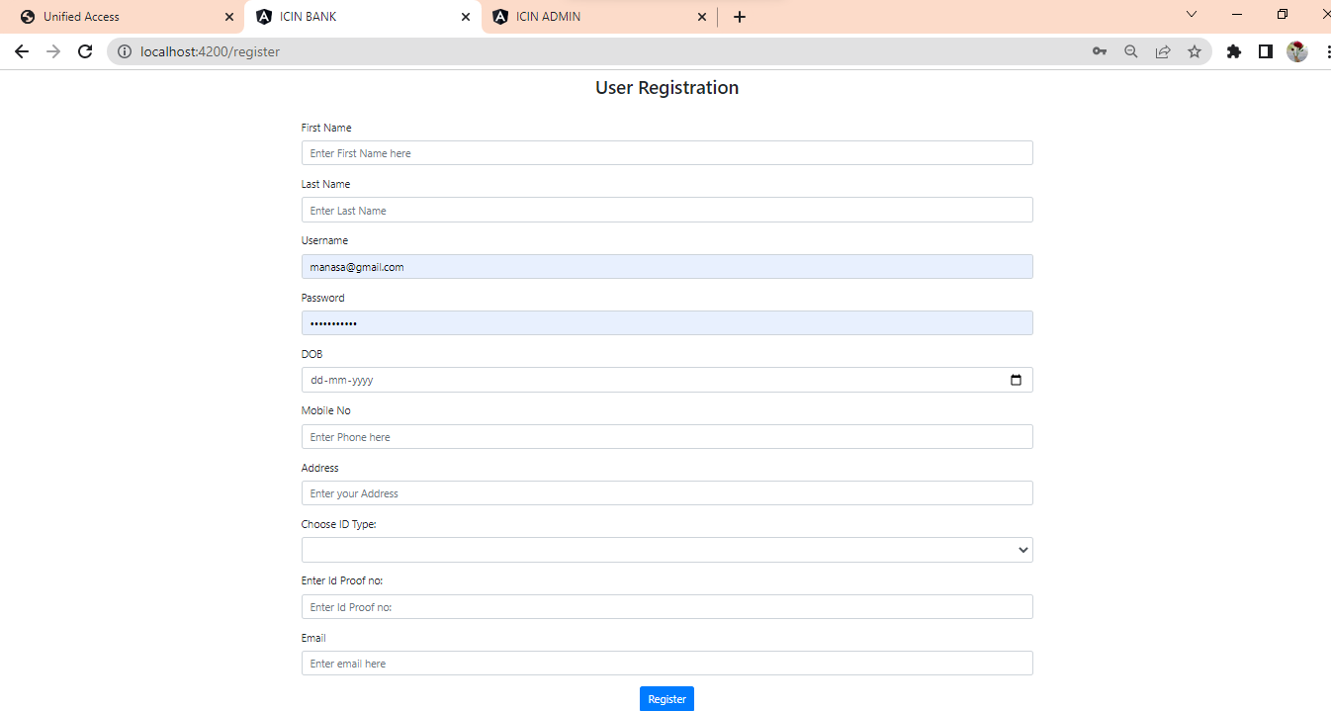
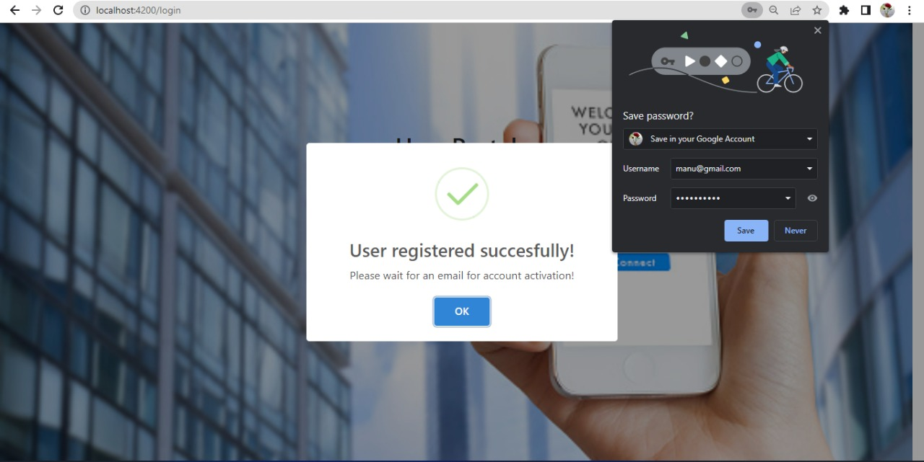

Slide 17
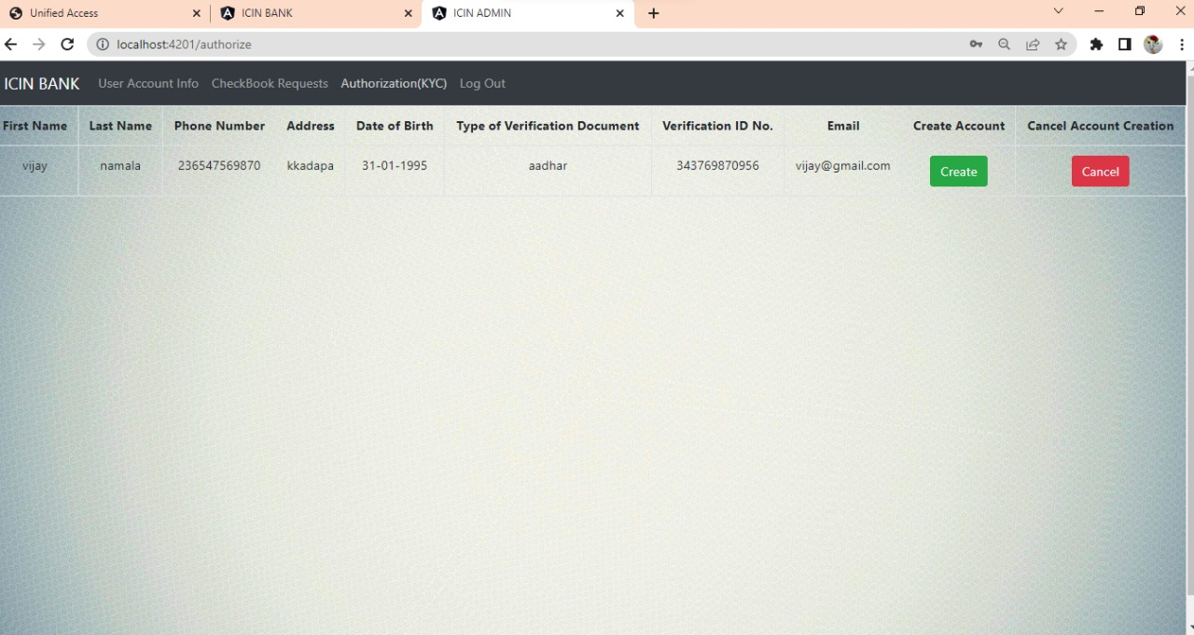
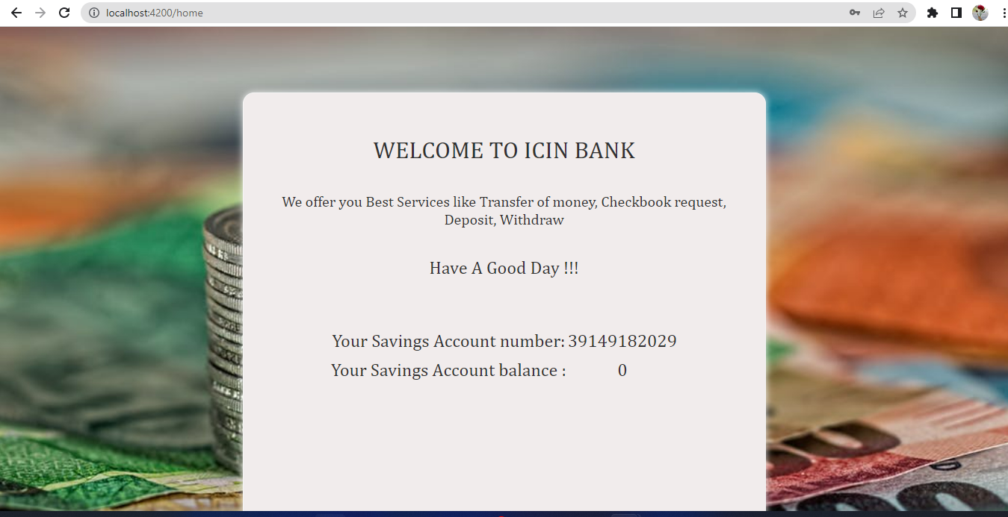

Slide 18
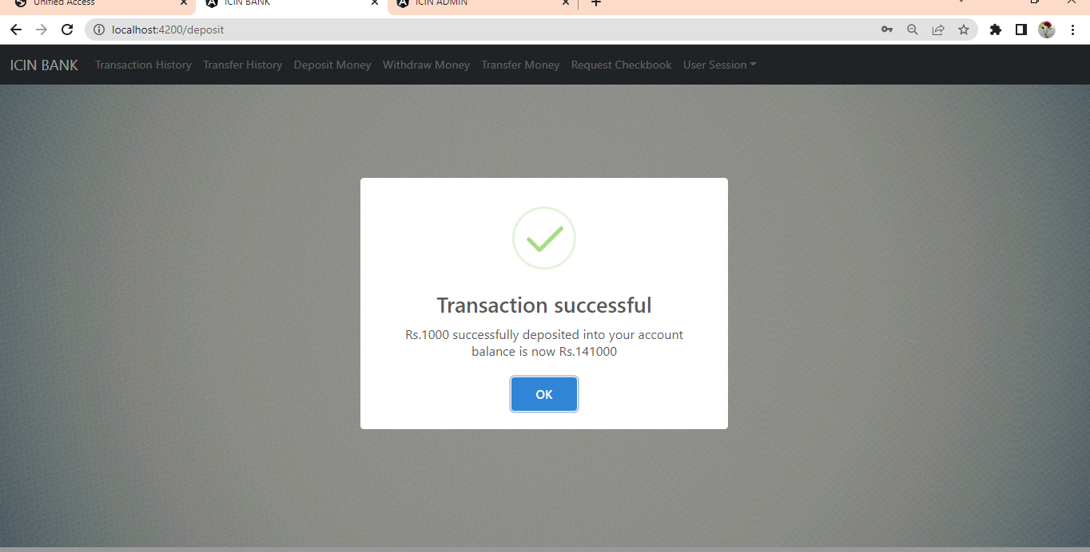
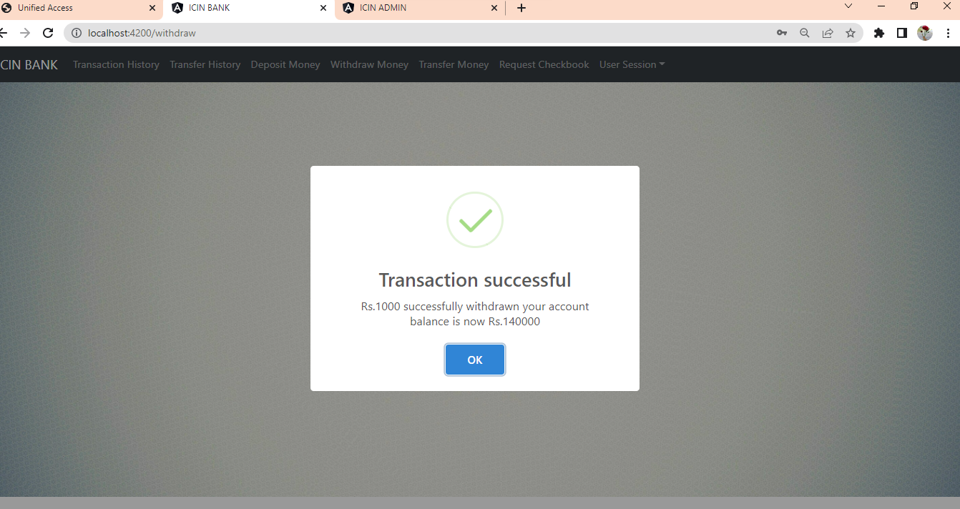

Slide 19
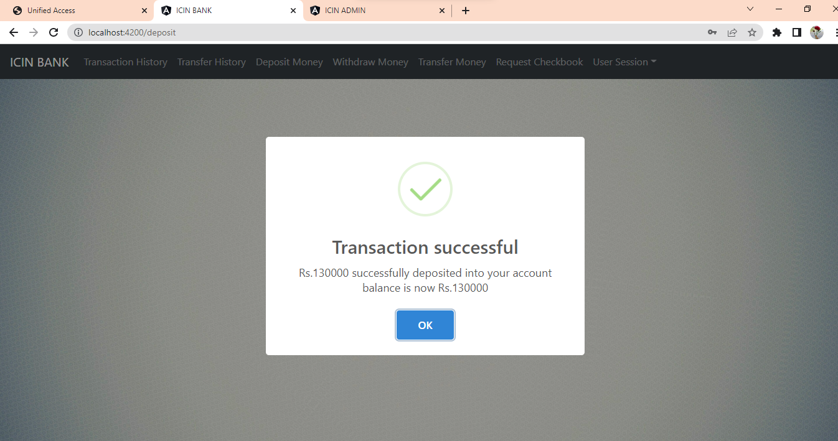
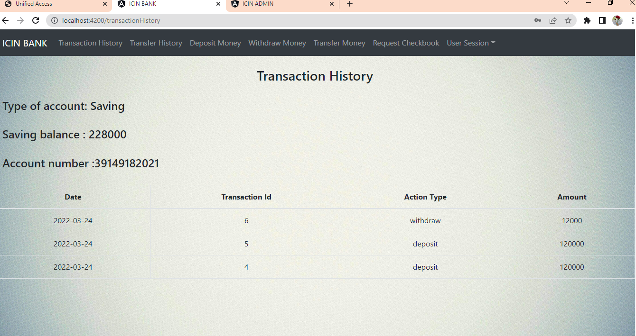

Slide 20
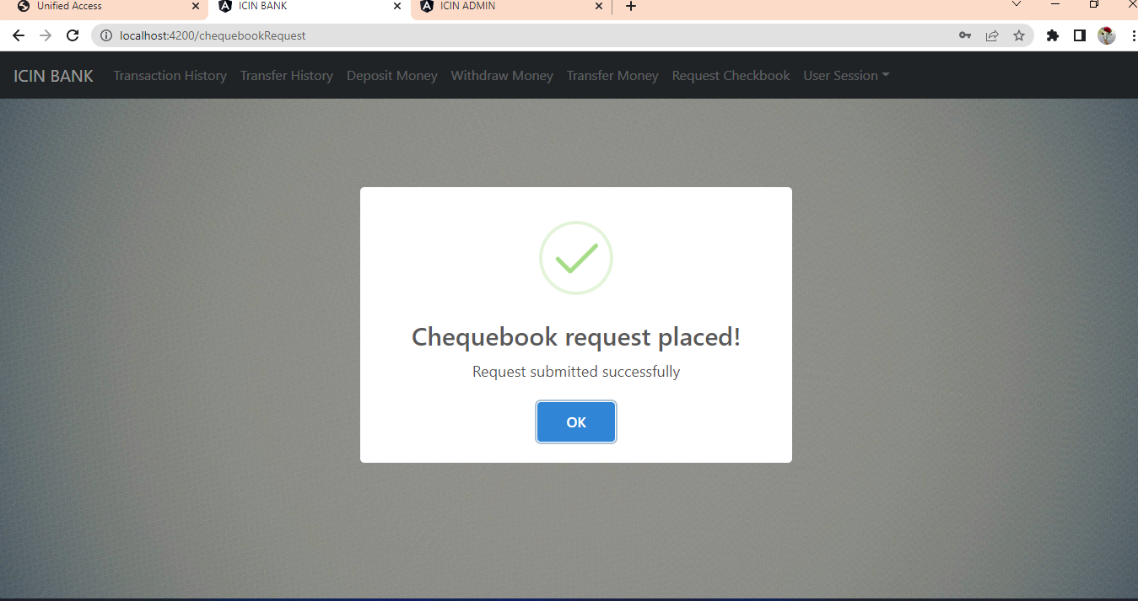
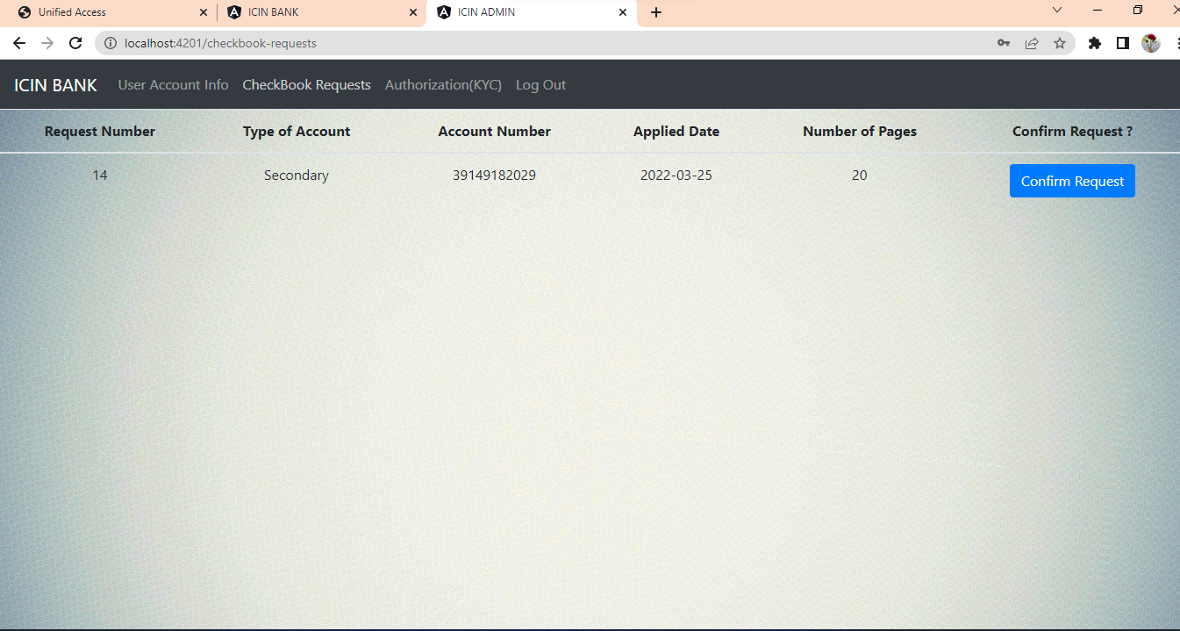

Slide 21
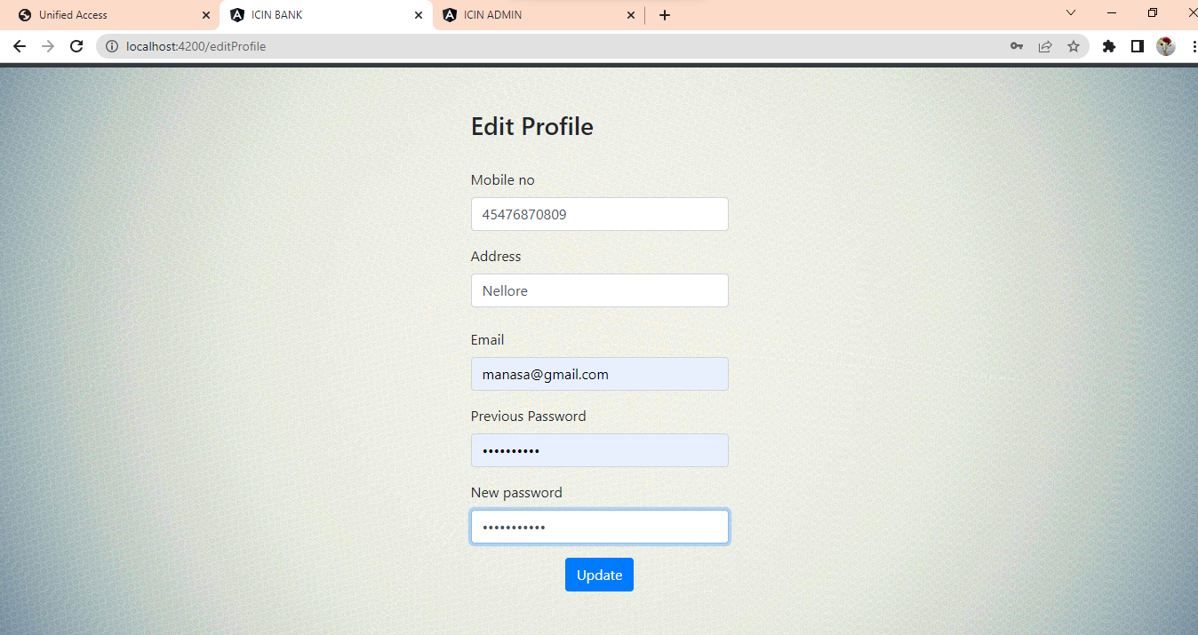
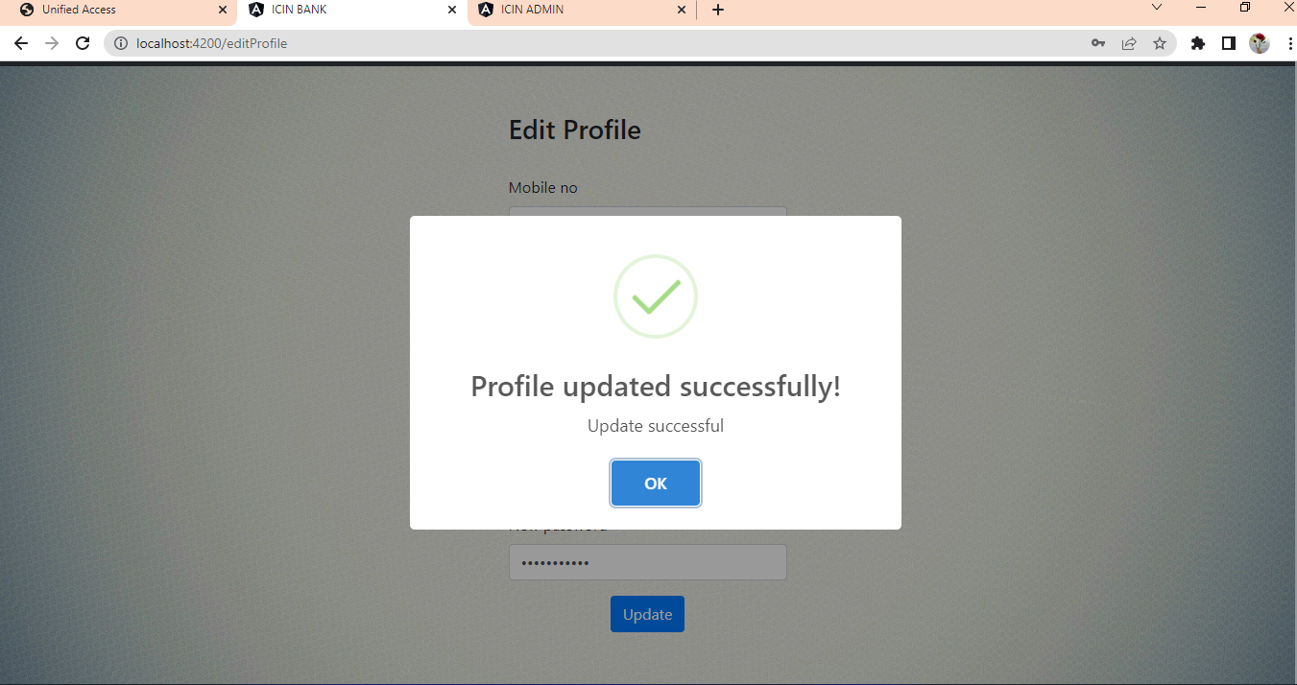

Slide 22
Features
Viewing Account balance
Viewing recent transactions
Ordering cheque books
Managing multiple users
Transfers

Slide 23
ADVANTAGES
Easy Fund Transaction between accounts.
Secure Banking.
Access 24/7.
Better Services.
Transfer Money.

Slide 24
Conclusion
The strategy of bank is to provide value added services and products to the consumers, utilizing the internet extensively. The main aim of E-banking or online banking is to make transactions through online processes and provide customers with more benefits. Providing internet banking is increasingly becoming a “need to have” than “nice to have” services.

Slide 25
